Slide 1
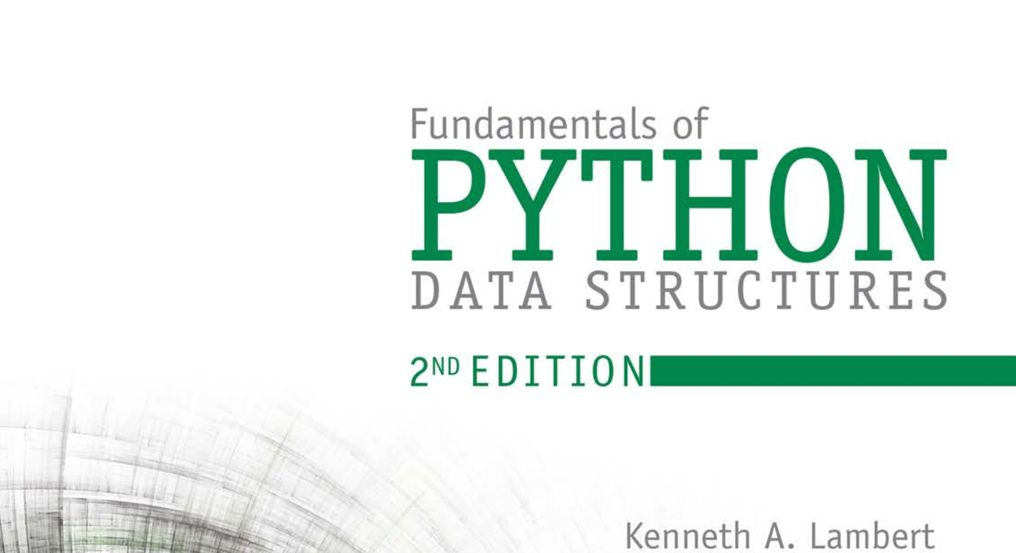
Database Systems: Design, Implementation, and Management 14th Edition
Chapter 1
Database Systems

Slide 2


National Economics University Faculty of Data Science & Artificial Intelligence
Fundamentals of Python: Data Structures – Algorithm Analysis
Instructor: Duc Minh Vu (FDA – SLSCM Lab)
Email: minhvd [at] neu.edu.vn
12/19/2024
Database System Design, Implementation And Management
2

Slide 3
Learning Objectives
After completing this chapter, you will be able to:
Measure the performance of an algorithm by obtaining running times and instruction counts with different data sets
Analyze an algorithm’s performance by determining its order of complexity, using big-O notation
Distinguish the common orders of complexity and the algorithmic patterns that exhibit them

Slide 4
Learning Objectives
After completing this chapter, you will be able to:
Distinguish between the improvements obtained by tweaking an algorithm and reducing its order of complexity
Write a simple linear search algorithm and a simple sort algorithm

Slide 5
11.1 Measuring the Efficiency of Algorithms
Measuring the Run Time of an Algorithm
use the computer’s clock to obtain an actual run time
benchmarking or profiling

Slide 6
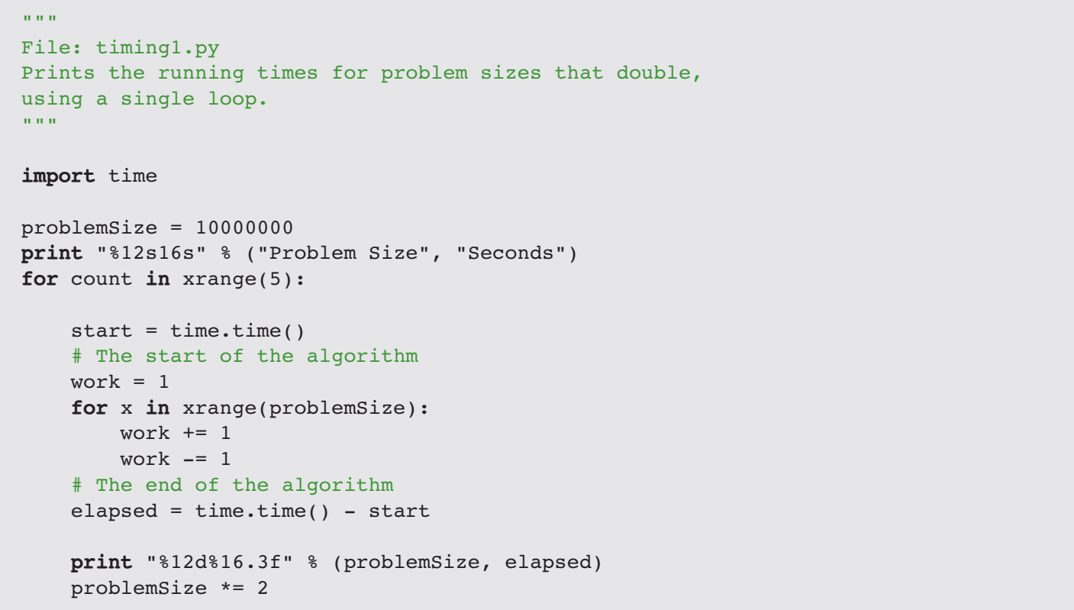

Slide 7
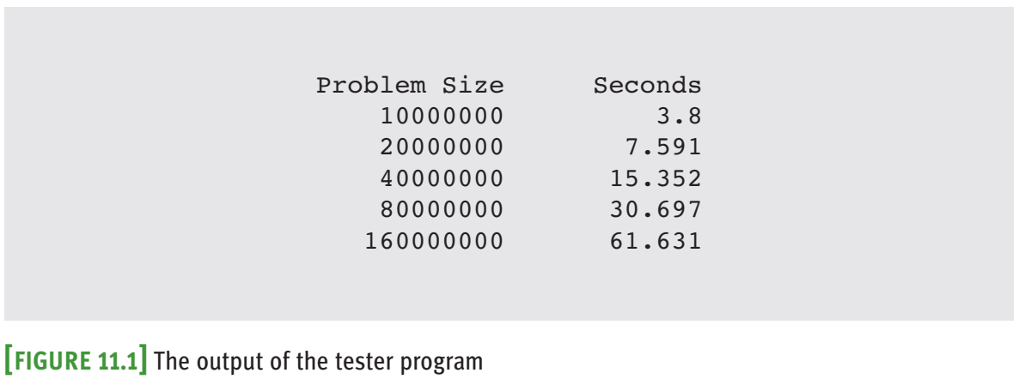

Slide 8


Slide 9
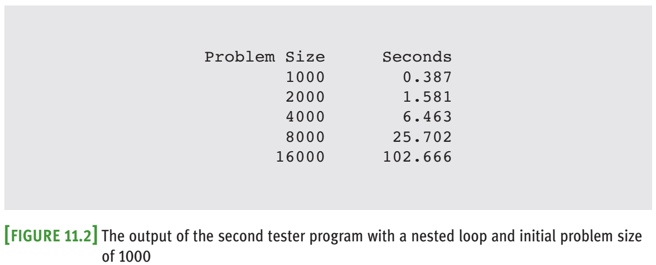
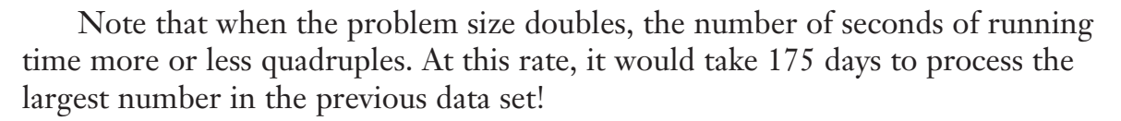

Slide 10
11.1.2 Counting Instructions
Count the instructions executed with different problem sizes.
Count the instructions in the high-level code in which the algorithm is written, not instructions in the executable machine language program.
Distinguish between two classes of instructions:
Instructions that execute the same number of times regardless of the problem size
Instructions whose execution count varies with the problem size

Slide 11
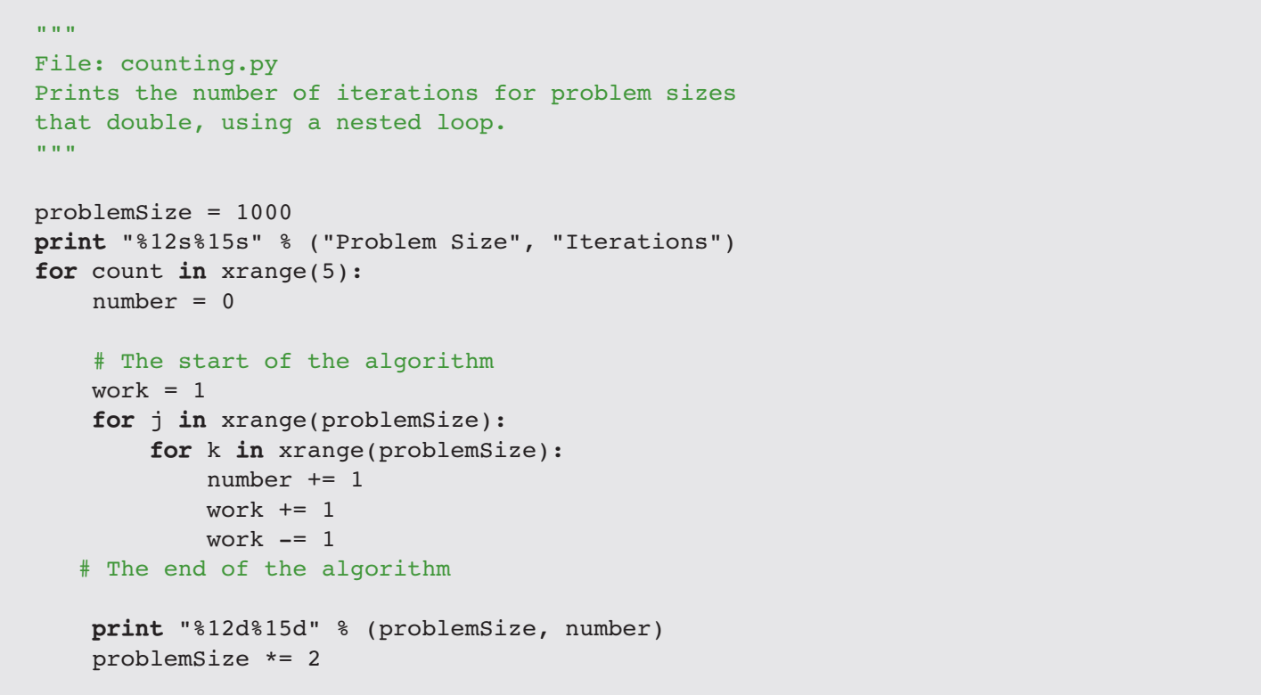

Slide 12
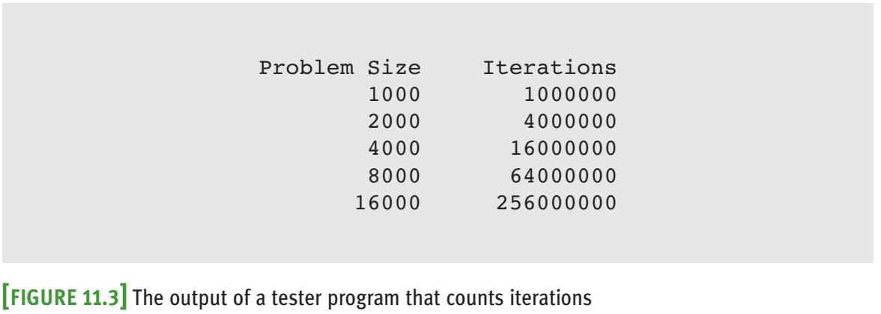

Slide 13
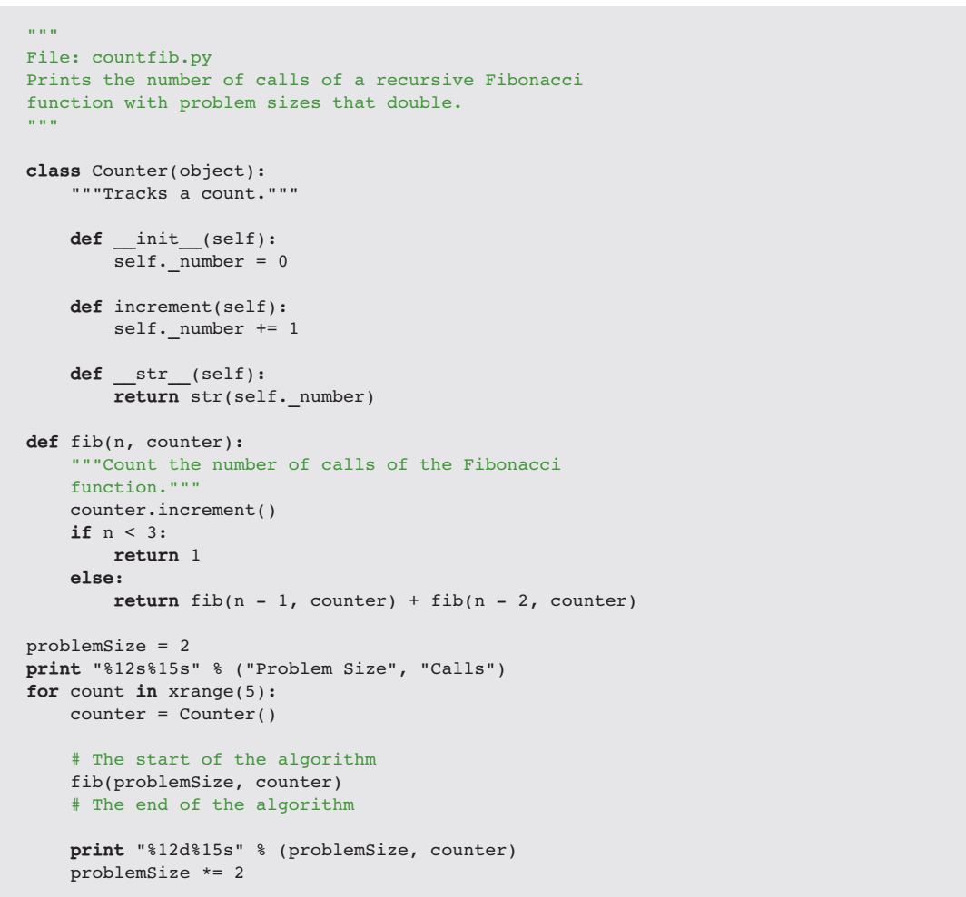

Slide 14
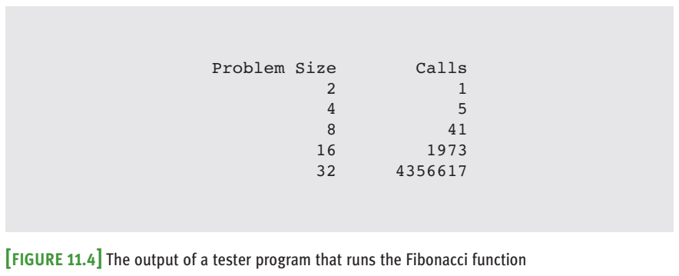

Slide 15
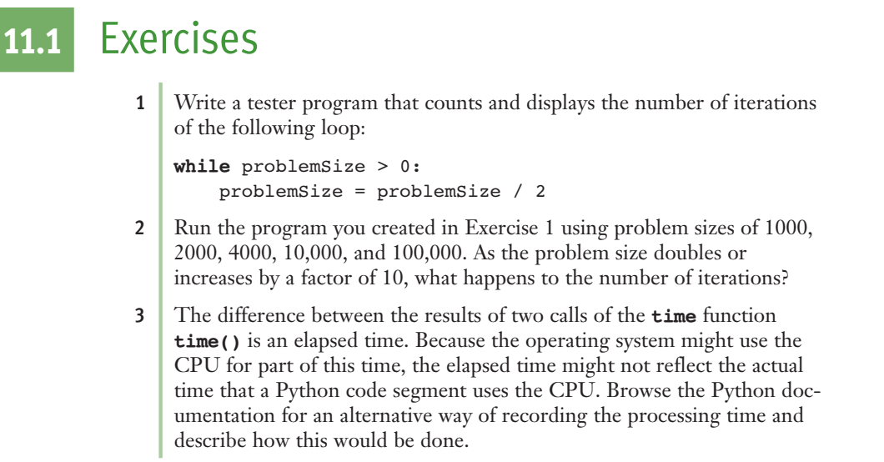

Slide 16
11.2 Complexity Analysis
A method of determining the efficiency of algorithms
Allows to rate algorithms independently of platform-dependent timings or impractical instruction counts.

Slide 17
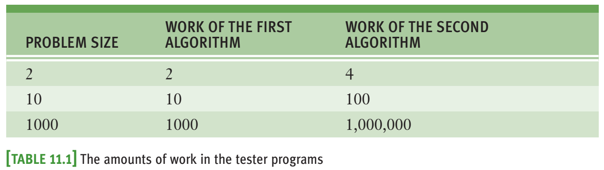
11.2.1 Orders of Complexity
Level of increasing when the size of the input increases

Slide 18
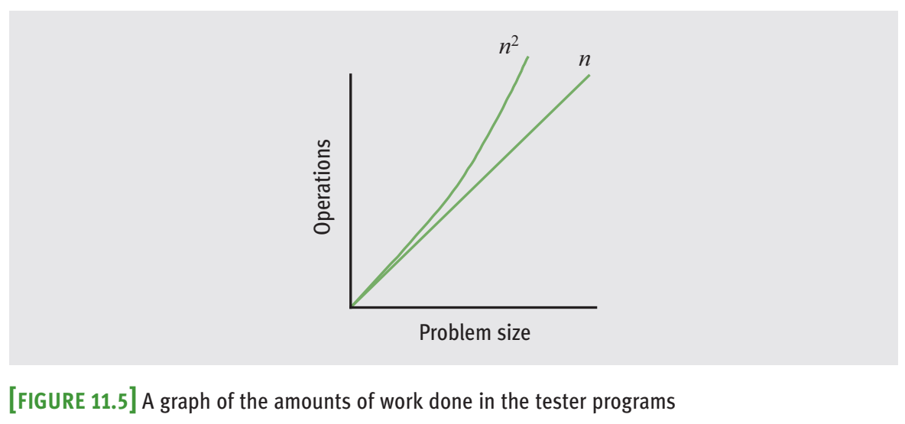

Slide 19
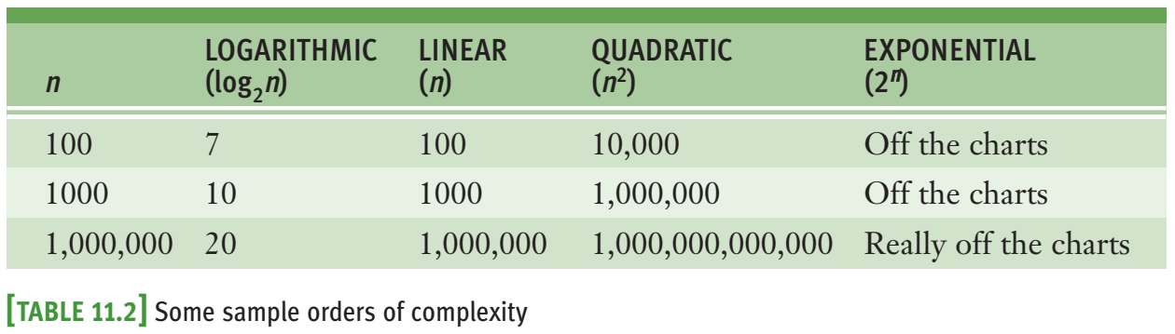
11.2.1 Orders of Complexity
Some popular order: const, linear, quadratic, logarithmic, polynomial, exponential

Slide 20
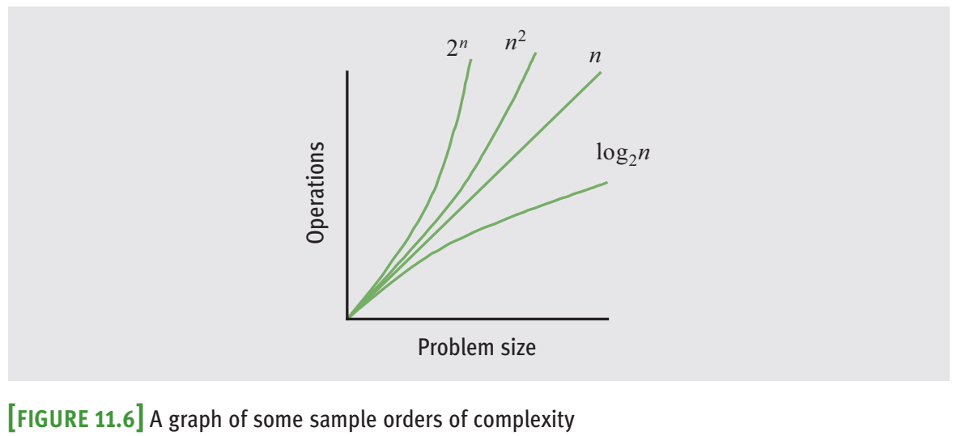

Slide 21
11.2.2 Big-O Notation
Can not count or evaluate precisely the number of operations
Focus on one term as dominant.
As input size becomes large, the dominant term becomes so large that the amount of work represented by the other terms can be ignore
Asymptotic analysis: the value of the function asymptotically approaches or approximates the value of its largest term as the input size becomes very large.
big-O notation: “O” stands for “on the order of,” a reference to the order of complexity of the work of the algorithm

Slide 22
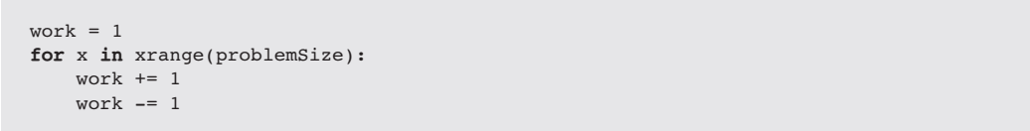
11.2.3 The Role of the Constant of Proportionality
Constant of proportionality involves the terms and coefficients that are usually ignored during big-O analysis.
However, when these items are large, they may have an impact on the algorithm, particularly for small and medium-sized data sets
Determine the constant?

Slide 23
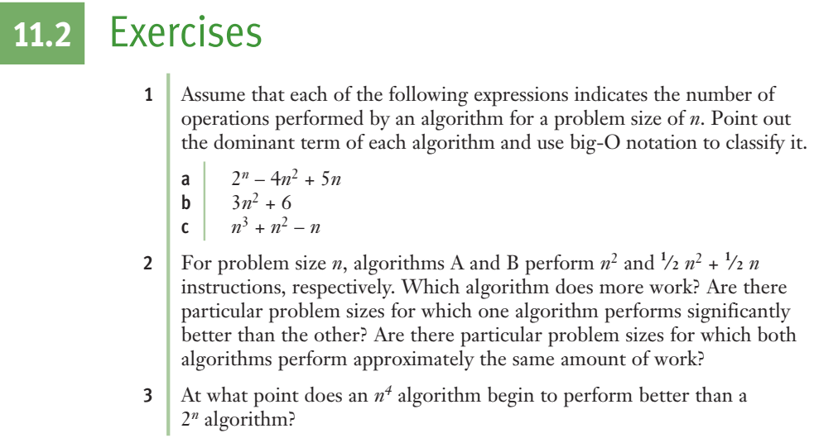

Slide 24
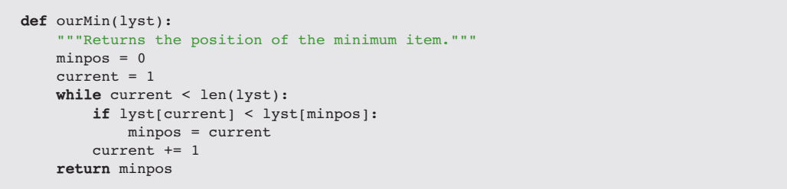
11.3 Search Algorithms
Search for a Minimum

Slide 25
11.3 Search Algorithms

Slide 26
11.3 Search Algorithms
Ignore three instructions outside the loop that execute the same number of times regardless of the size of the list.
The comparison in the if statement and the increment of current execute on each pass through the loop.
Thus, the algorithm must make n – 1 comparisons for a list of size n.
Therefore, the algorithm’s complexity is O(n)

Slide 27
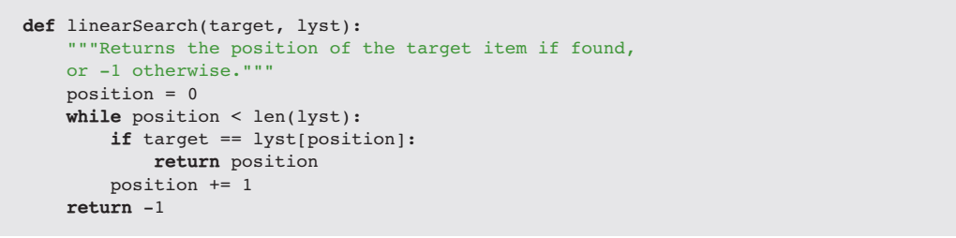
11.3 Search Algorithms
11.3.2 Linear Search of a List

Slide 28
11.3 Search Algorithms
11.3.2 Linear Search of a List

Slide 29
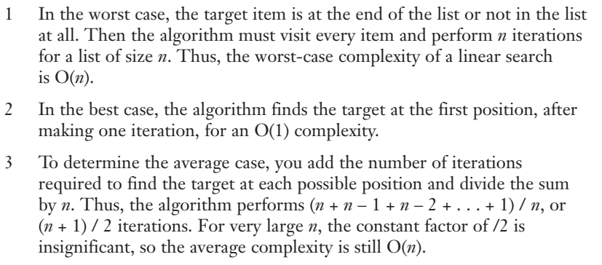
11.3.3 Best-Case, Worst-Case, and Average-Case Performance
We focus more about average and worst-case performances than about best-case performances.

Slide 30
11.3.4 Binary Search of a List
When searching sorted data, you can use a binary search.
Assume that the items in the list are sorted in ascending order.
The search algorithm goes to the middle position in the list and compares the item at that position to the target.
If there is a match, the algorithm returns the position.
Otherwise, if the target is less than the current item, the algorithm searches the portion of the list before the middle position.
If the target is greater than the current item, the algorithm searches the portion of the list after the middle position.
The search process stops when the target is found or the current beginning position is greater than the current ending position.

Slide 31
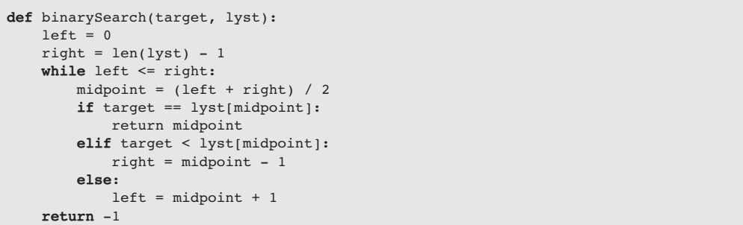
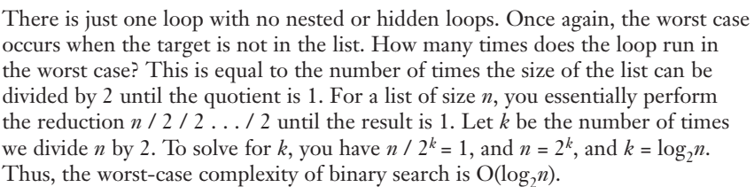

Slide 32
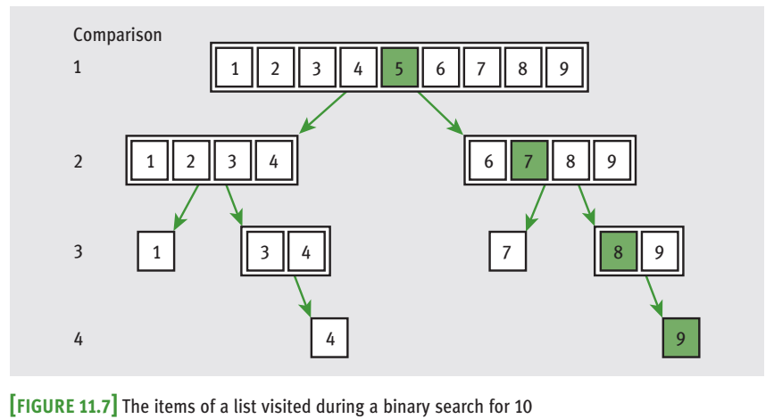

Slide 33
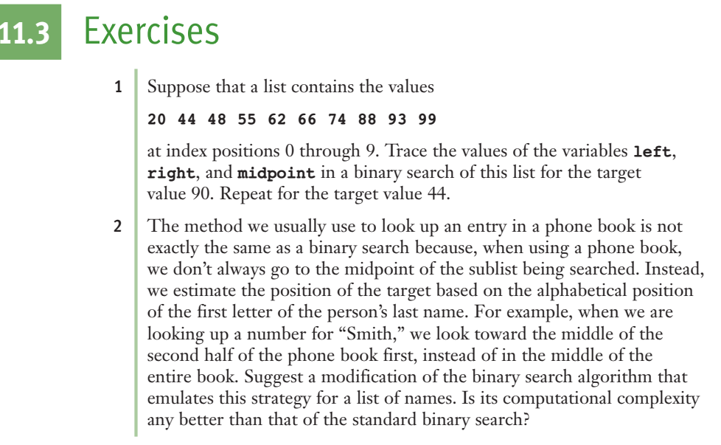

Slide 34
11.4 Sort Algorithms

Slide 35
11.4 Sort Algorithms
Computer scientists have devised many ingenious strategies for sorting a list of items.
We examine some algorithms that are easy to write but are inefficient.
Each of the Python sort functions that we develop here operates on a list of integers and uses a swap function to exchange the positions of two items in the list

Slide 36
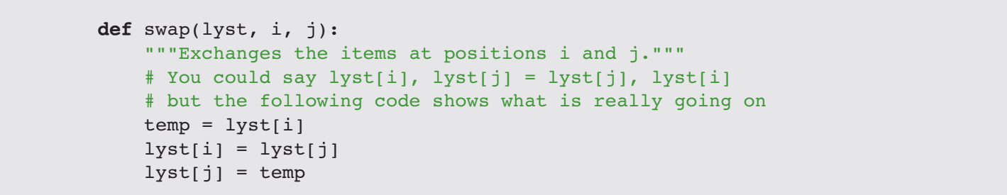

Slide 37
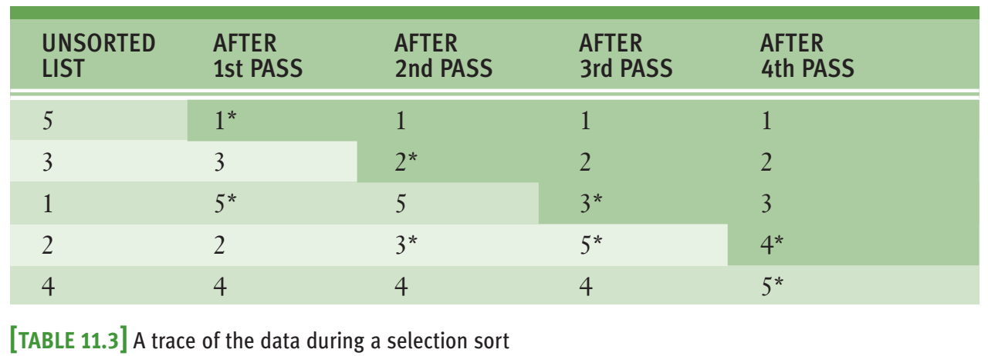
11.4.1 Selection Sort
Each pass of the algorithm selects a single item to be moved.
Pass k moves/swaps the k-th smallest element to its correct position.

Slide 38
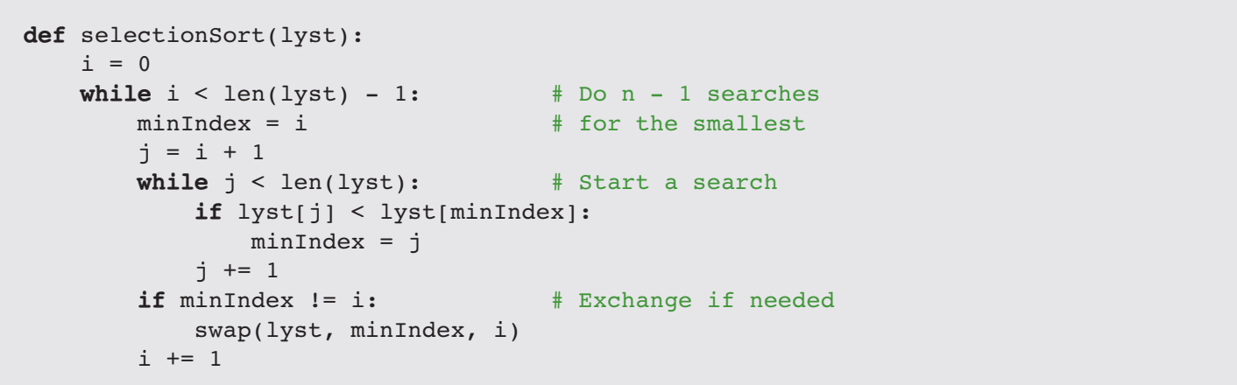

Slide 39
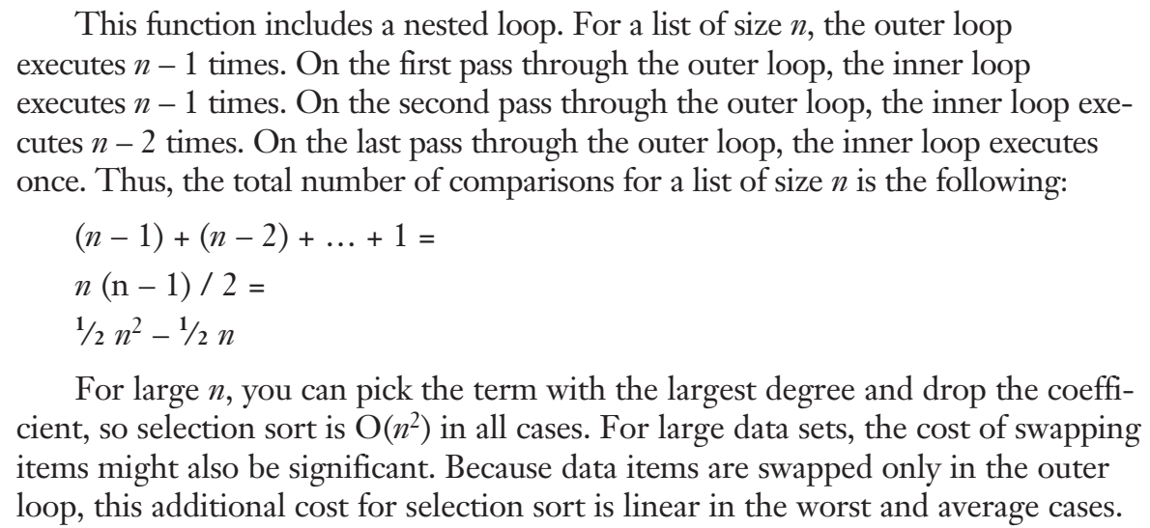

Slide 40
11.4.2 Bubble Sort
Compare two consecutive items
Each time the items in the pair are out of order, the algorithm swaps them
The effect of bubbling the largest items to the end of the list.
The k-th iteration will bubble the k-th largest element to its correct position

Slide 41
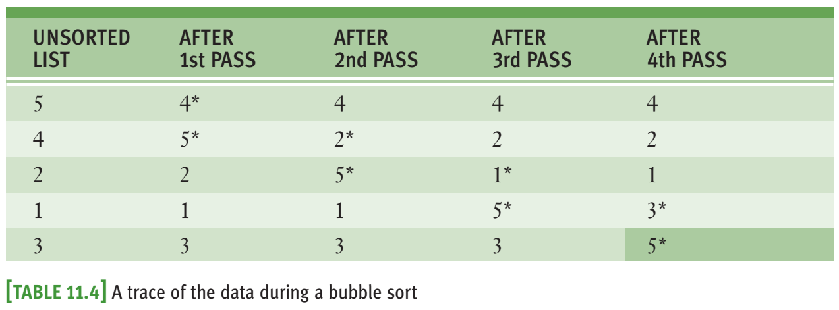

Slide 42
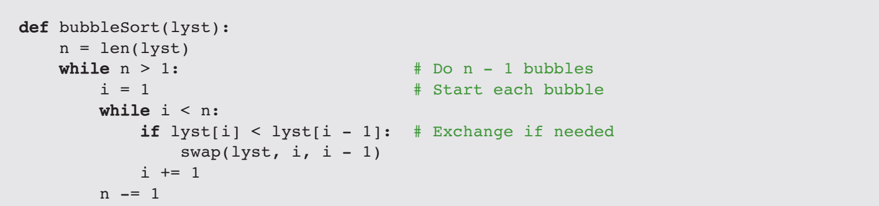

Slide 43
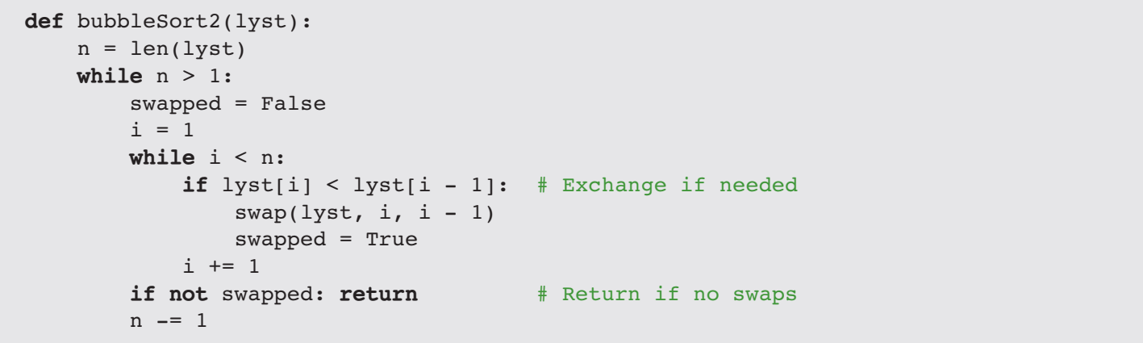

Slide 44
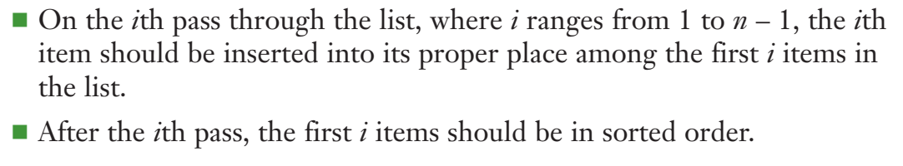
11.4.3 Insertion Sort
In the k-th pass, insert the k-th element into the already sorted sub-array of the first (k-1) elements to keep k first elements to be in order.

Slide 45
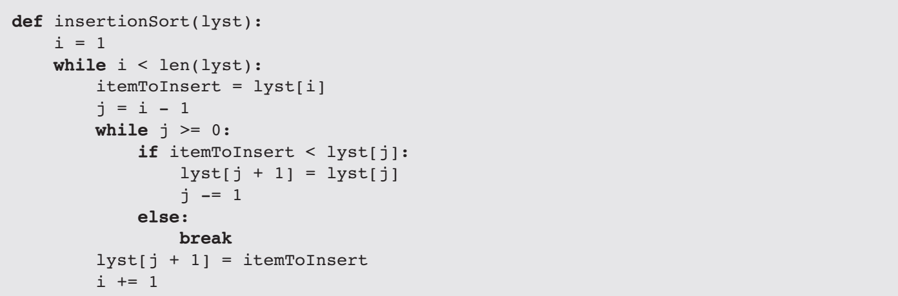

Slide 46
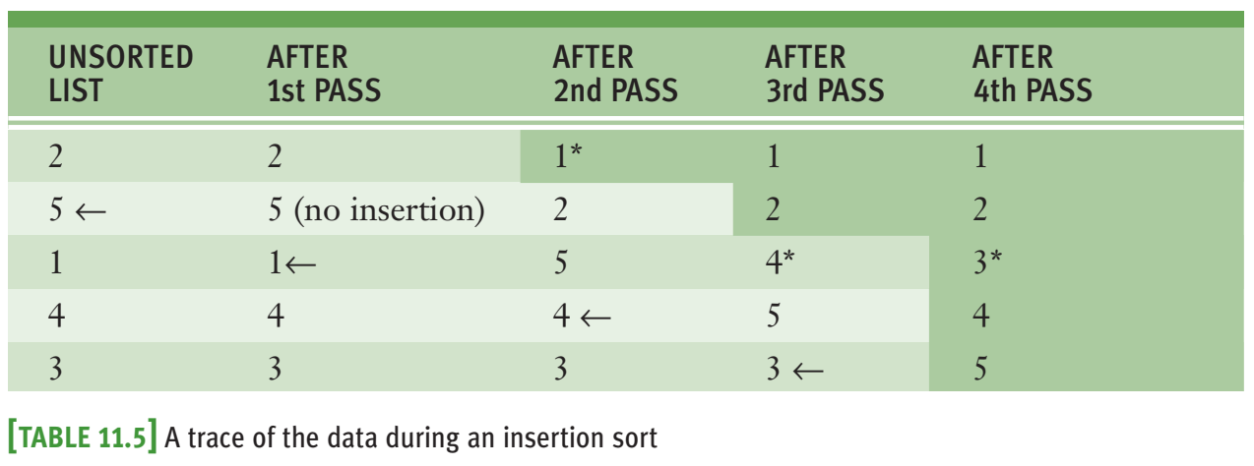

Slide 47
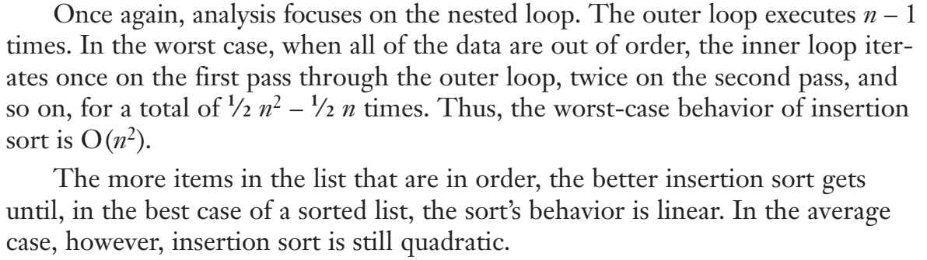

Slide 48
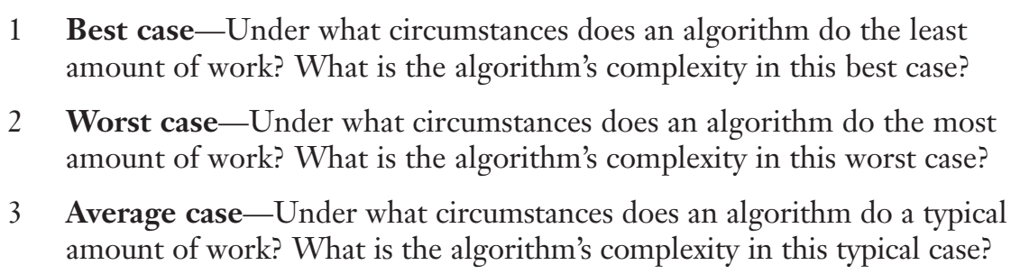
11.4.4 Best-Case, Worst-Case, and Average-Case Performance Revisited

Slide 49
11.4.4 Best-Case, Worst-Case, and Average-Case Performance Revisited
Search for a minimum: best-case, worst-case, and average-case performances are O(n).
Linear search: best-case performance is O(1) and its worst-case performance is O(n).
Average case: (1 + 2 + . . . + n) / n, or n / 2 comparisons; so O(n)
Bubble sort’s best-case performance is O(n); worst-case performance is clearly O(n^2).
Bubble sort’s average-case performance is closer to O(n^2) than to O(n)

Slide 50
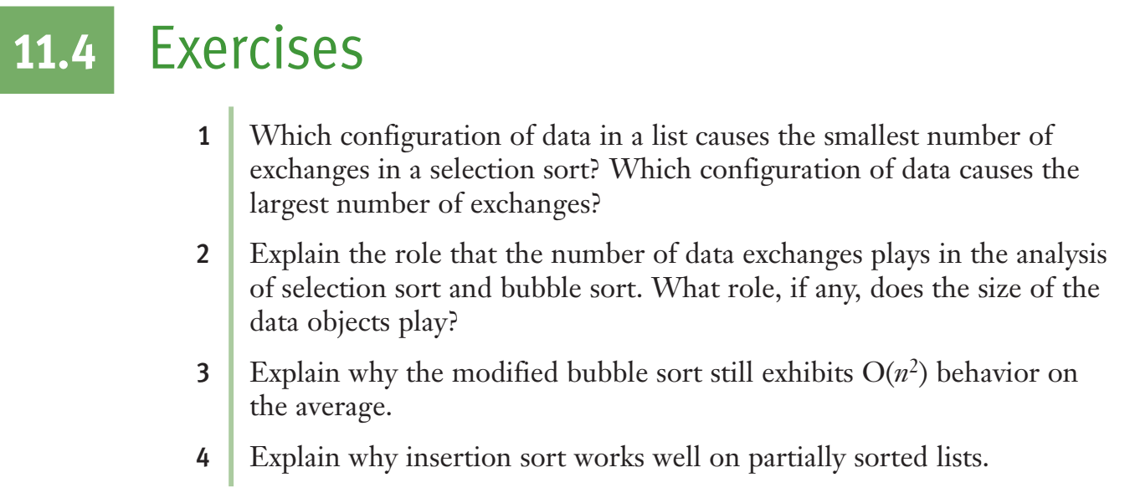

Slide 51
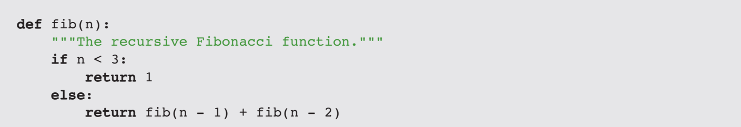
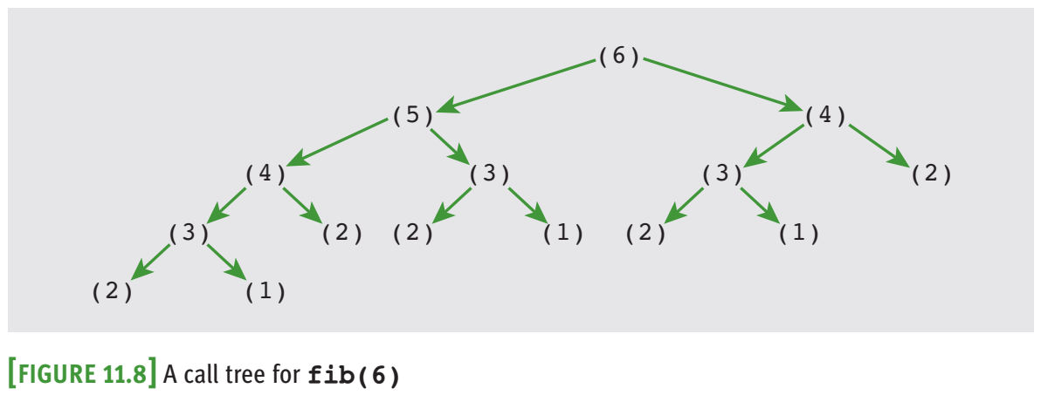
11.5 An Exponential Algorithm: Recursive Fibonacci

Slide 52
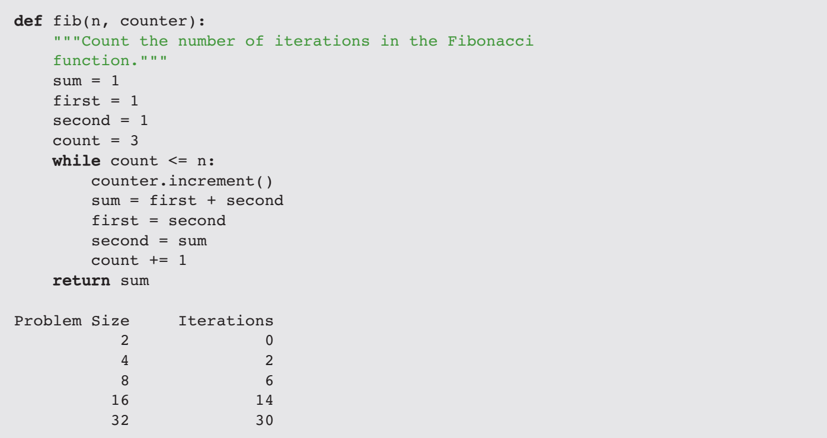
11.6 Converting Fibonacci to a Linear Algorithm

Slide 53
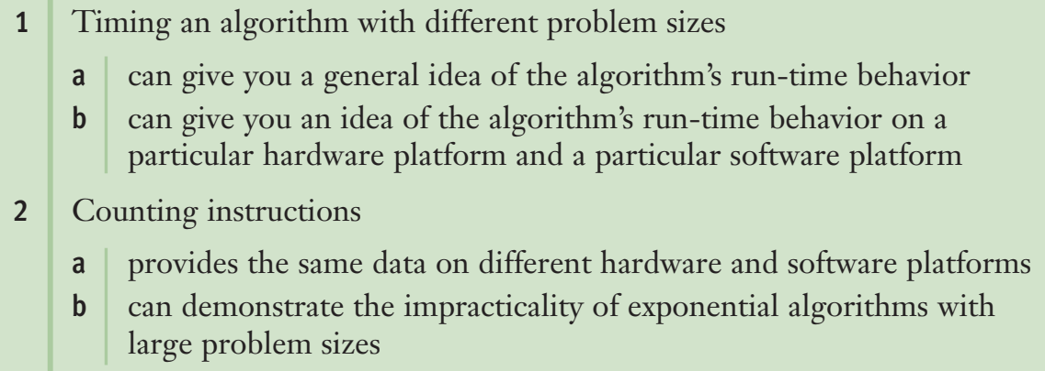
REVIEW QUESTIONS

Slide 54
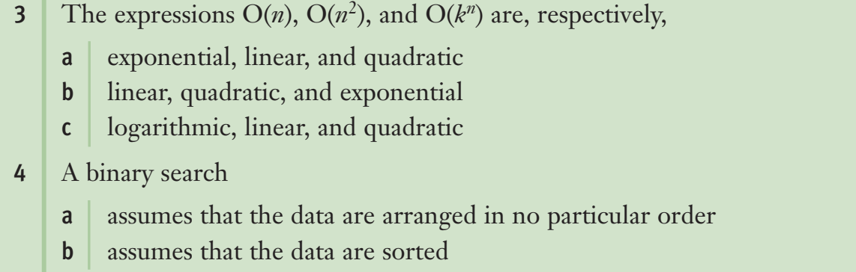

Slide 55
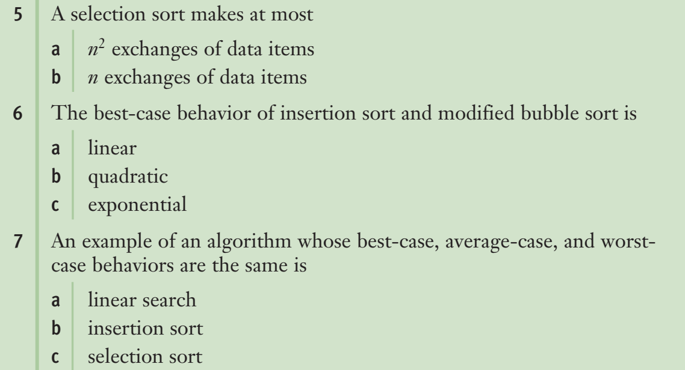

Slide 56
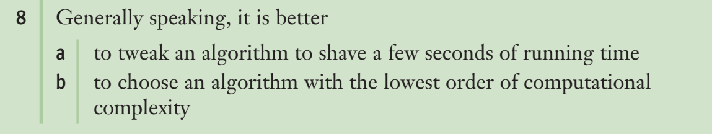

Slide 57
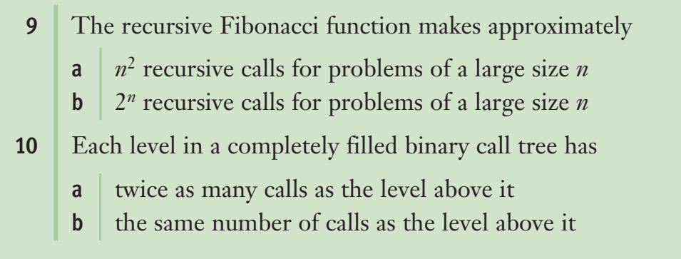

Slide 58
Faster Sorting

Slide 59
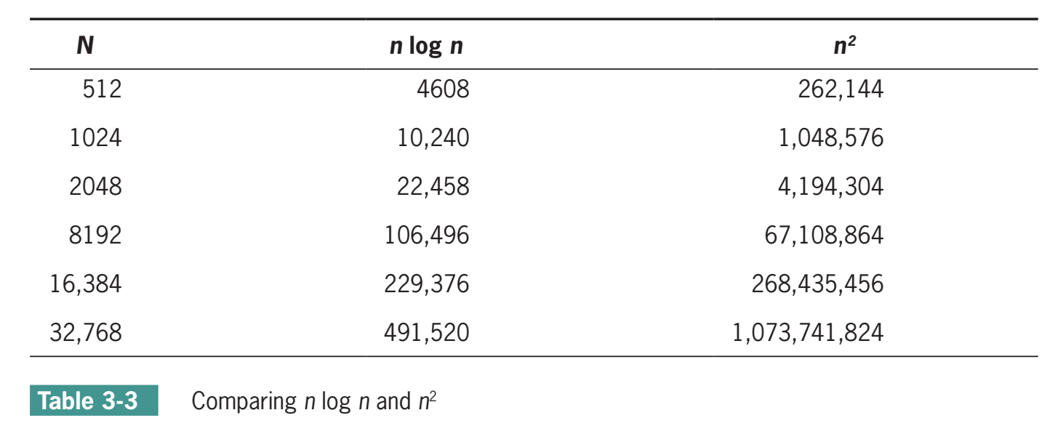

Slide 60
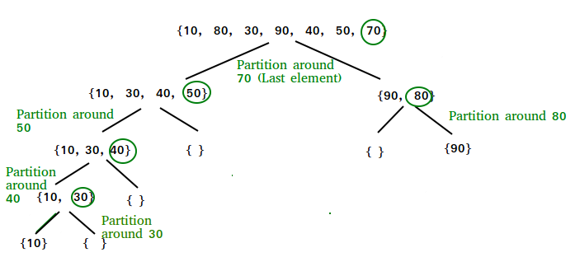
Quicksort

Slide 61
Quicksort
QuickSort - Data Structure and Algorithm Tutorials - GeeksforGeeks
1) Selecting the item at the list’s midpoint. This item is called the pivot.
2) Partition items in the list so that all items less than the pivot are moved to the left of the pivot, and the rest are moved to its right. The final position of the pivot itself varies, depending on the actual items involved.
3) Divide and conquer. Reapply the process recursively to the sublists formed by splitting the list at the pivot. One sublist consists of all items to the left of the pivot (now the smaller ones), and the other sublist has all items to the right (now the larger ones).
4) The process terminates each time it encounters a sublist with fewer than two items.

Slide 62
Partition
Implement Various Types of Partitions in Quick Sort in Java - GeeksforGeeks
1. Swap the pivot with the last item in the sublist.
2. Establish a boundary between the items known to be less than the pivot and the rest of the items. Initially, this boundary is positioned immediately before the first item.
3. Starting with the first item in the sublist after the boundary, scan across the sublist. Every time you encounter an item less than the pivot, swap it with the first item after the boundary and advance the boundary.
4. Finish by swapping the pivot with the first item after the boundary.

Slide 63
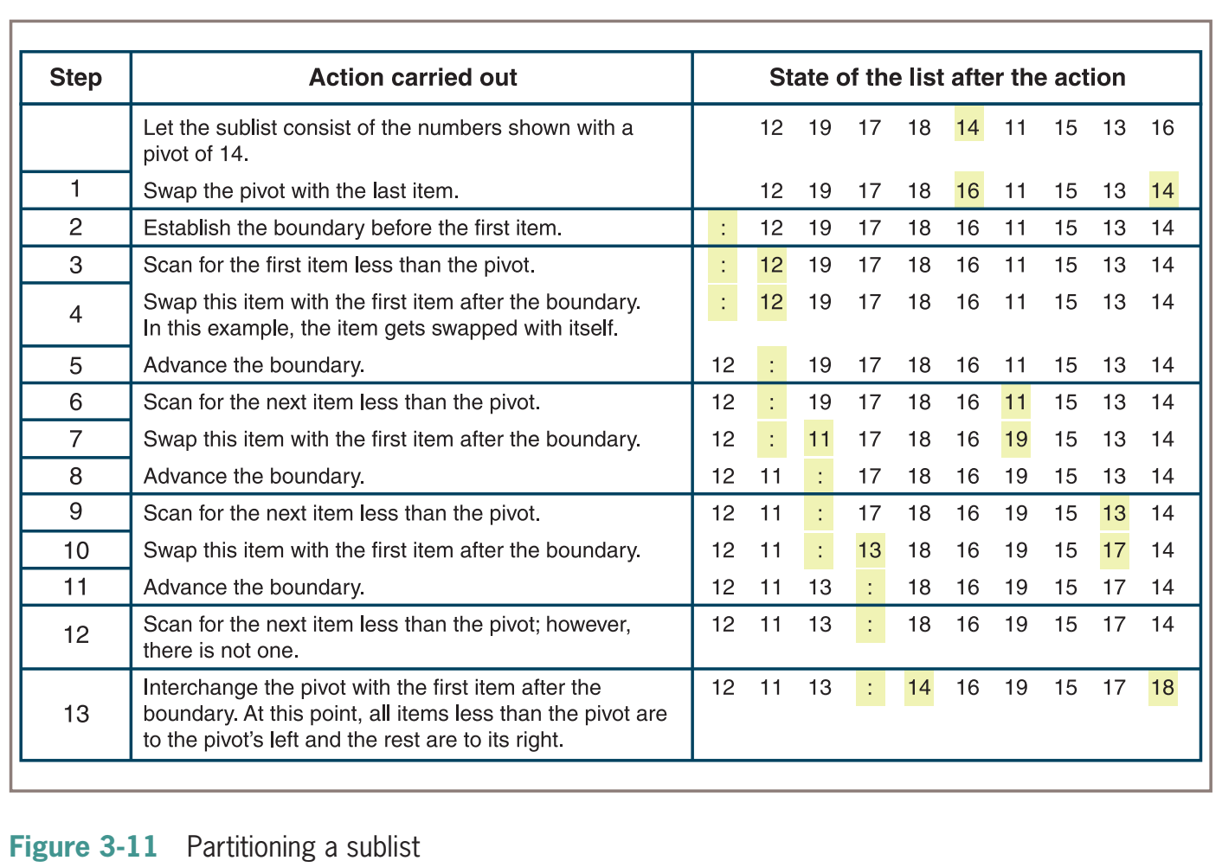

Slide 64
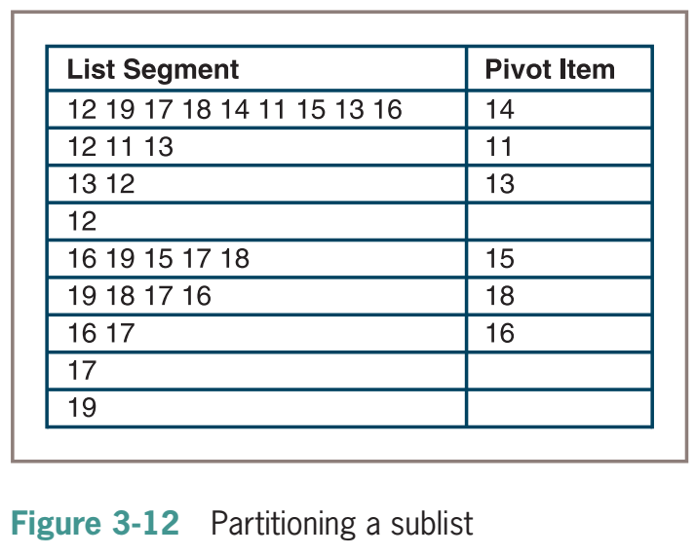

Slide 65
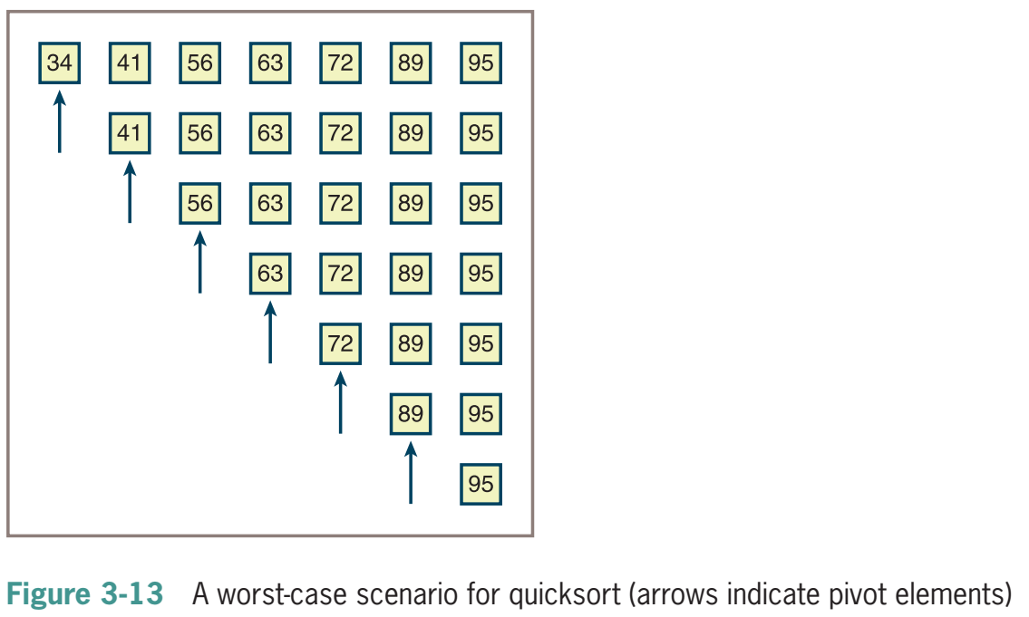

Slide 66
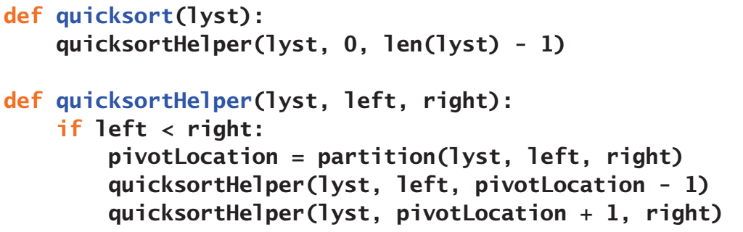
Implementation of Quicksort

Slide 67


Slide 68



Slide 69

Time and Space Complexity Analysis of Quick Sort - GeeksforGeeks

Slide 70


Slide 71
Merge Sort

Slide 72


Slide 73
Merge Sort
Merge Sort - Data Structure and Algorithms Tutorials - GeeksforGeeks
Compute the middle position of a list and recursively sort its left and right sublists (divide and conquer).
Merge the two sorted sublists back into a single sorted list.
Stop the process when sublists can no longer be subdivided.

Slide 74


Slide 75


Slide 76


Slide 77


Slide 78


Slide 79


Slide 80


Slide 81


Slide 82


Slide 83
Practice
Top MCQs on MergeSort Algorithm with Answers – GeeksforGeeks
Top MCQs on QuickSort Algorithm with Answers - GeeksforGeeks
Practice | GeeksforGeeks | A computer science portal for geeks

